Slide 1
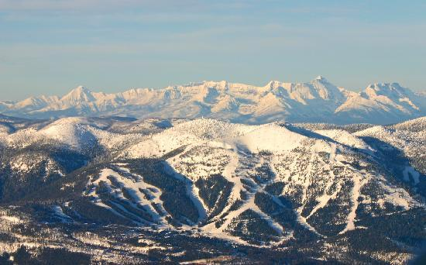
Big Mountain Resort Pricing

Slide 2
Question to be Answered
What is the optimal pricing model for Big Mountain Resort to capitalize on the amenities of their resort to adjust prices before the upcoming ski season?

Slide 3
Problem Identification
Criteria for Success
This project will end with a presentation to stakeholders that outlines the optimal pricing model for the upcoming ski season based on numerous factors as opposed to a singular factor (average price now).
Scope of Solution Space
Subset the current list of parks to peer parks with similar amenities (runs, lifts, night skiing, terrain parks) and season lengths (from projectedDaysOpen)
Use this subset of peer parks to present the appropriate pricing for Big Mountain Resort.
Possible Constraints
Any increase in ticket price could change the number of visitors to the park.
Any decrease in ticket price could change the profitability of the resort if not met with rise in customers.
The data doesn’t provide information about subjective information (like views from the mountain, the resort’s non-skiing amenities, etc.) which also plays a role in pricing.
Big Mountain resort has an increased operating costs $1,540,000 this year.
Data Source
CSV from the database manager with 26 data points on 330 resorts in the same market share as Big Mountain Resort

Slide 4
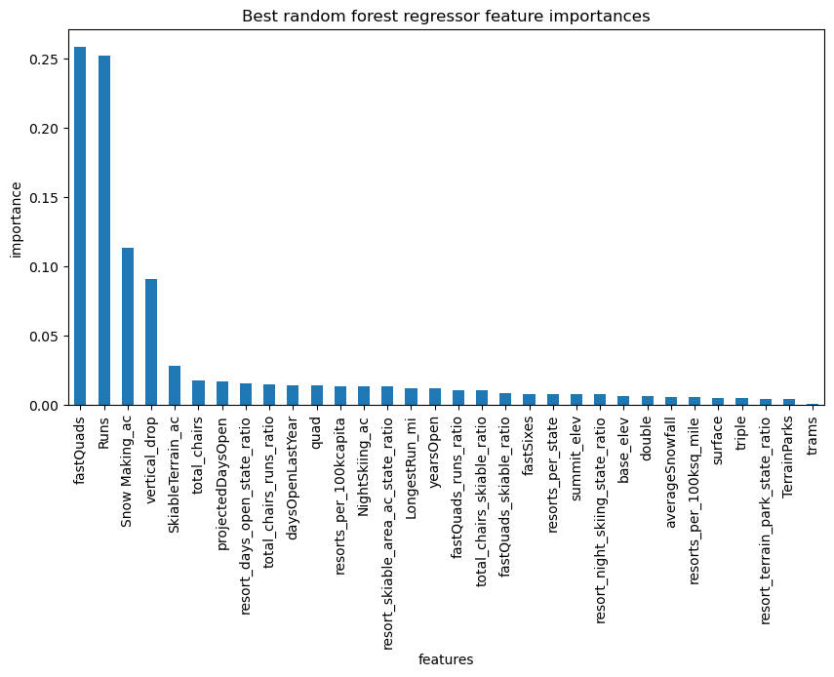
Recommendations & Key Findings
Model shows a best ticket price of $95.87 for Big Mountain Resort with expected modeling error of $10.39.
The price for Big Mountain should like somewhere between $85 and $105 per adult ticket
The model shows the most important resort amenities as Fast Quads, Runs, Snow Making Acres & Vertical Drop

Slide 5
Model Creation
After studying several algorithms with regard to ticket price, we had two models that outperformed the rest:
A Linear Regression
A Random Forest generator
We used 70% of our data set to train a model and the remaining 30% to test the two models. In studying the two models The Random Forest regressor was our most consistent model with almost $1 in ticket price less in variance than the linear regression model when looking at the mean average error for the two models.

Slide 6
Model Results
Looking at this Random Forest generator data, the model shows that Big Mountain should be pricing tickets at $95.87, with an error of $10.39.
So, at minimum, Big Mountain should increase prices to at least $85, which would offset the cost of the new lift as the new lift cost would be offset by an increase of $0.88 per ticket.
All price increases beyond that amount would add additional revenue.
As we examine our model, accounting for error, Big Mountain is still priced lower than the minimum would recommend.

Slide 7
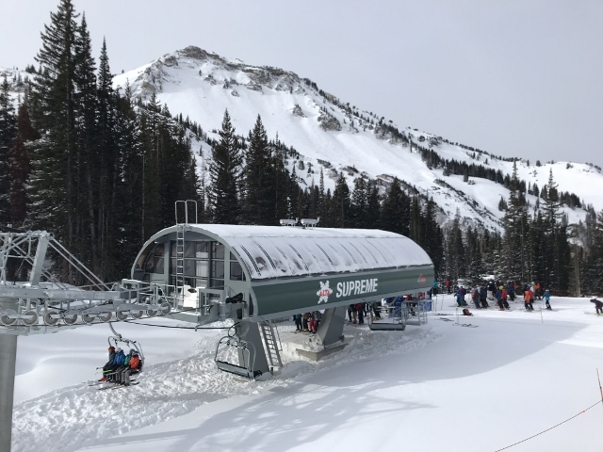
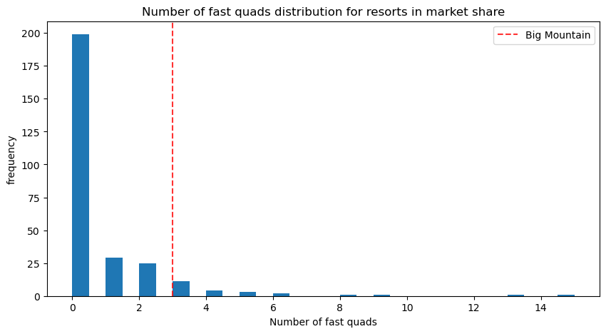
Model Analysis
Our model shows that Fast Quads are highly valuable to the ticket pricing for resorts.
Big Mountain Resort boasts Fast Quads and many of our comparison resorts do not have this particularly amenity.
We need to let our customers know about this advantage and use it to set our price.

Slide 8
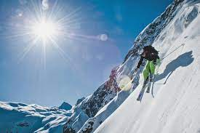
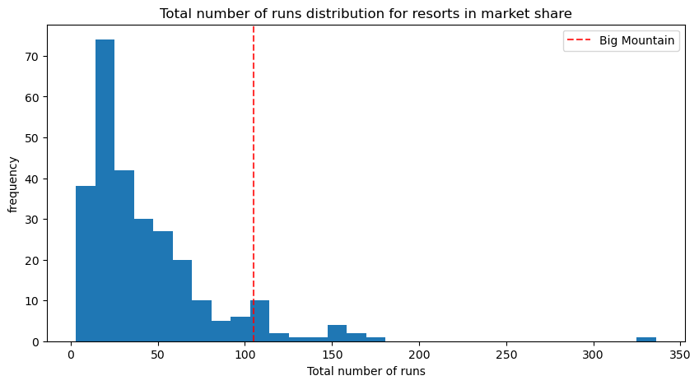
Model Analysis
Amongst our market, we boast a large number of runs. Runs are also a big indicator of price for ski resorts. This shows that we should be promoting our number of runs, along with Vertical Drop, as these are two of the biggest indicators of prices amongst our peer resorts.

Slide 9
Future Analysis Required
Two of the Board Scenarios Require Future Analysis
The addition of another run that would increase vertical drop by 150 feet and the number of total runs and chairs by one each.
Would warrant a ticket price increase of $8.60. This addition would be a strong revenue addition to Big Mountain.
The scenario with closing up to 10 runs needs to be studied in greater detail.
One run closure would not affect projected ticket prices, but 2 runs would show a drop in ticket prices and anything beyond five runs dropped shows a large drop off in the daily ticket price. Any run closures would need to be analyzed via run usage data and survey data of our customers about their usage of runs.

Slide 10
Conclusion
Big Mountain Resort is not charging as much as the resorts with similar amenities and could offset the cost of the new lift with an $0.88 price increase.
The rest of the price increase would be greater revenues and more profits as a result.

